Slide 1
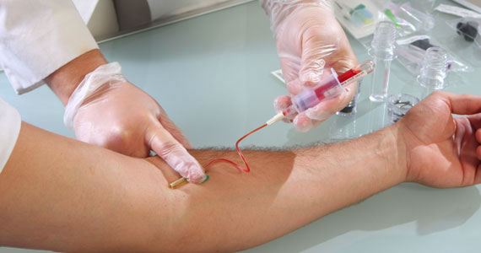
COLLECTION, TRANSPORT AND PROCESSING OF SPECIMEN

Slide 2
GENERAL CONCEPTS
Specimen collection and transportation are critical consideration because the laboratory result depends upon the quality of specimen and its condition on arrival in the lab.
Specimens should be collected with appropriate techniques like:
Specimen should be obtained to minimize contamination.
Specimen should be collected during acute phase and before antibiotic administration.
Specimen should be collected according to the manual/ instructions which includes safety considerations, selection of appropriate anatomic site, collection instruction, transportation instruction, labelling insruction and other special instructions.

Slide 3
BLOOD
In healthy subjects, the blood is sterile.
Blood is cultured to detect and identify bacteria or other cultivable microorganisms (yeasts, ﬁlamentous fungi).
The presence of such organisms in the blood is called bacteraemia or fungaemia, and is usually pathological.
Septicaemia is a clinical term used to describe bacteraemia with clinical manifestations of a severe infection, including chills, fever, malaise, toxicity, and hypotension, the extreme form being shock.

Slide 4
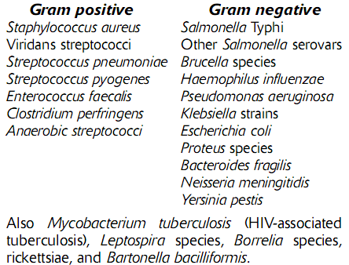
POSSIBLE BACTERIAL PATHOGENS IN BLOOD

Slide 5
BLOOD COLLECTION
blood should be taken before antibiotics are administered.
The best time is when the patient is expected to have chills or a temperature spike.
It is recommended that two or preferably three blood cultures be obtained, separated by intervals of approximately 1 hour.
Blood for culture must be collected as asceptically as possible.
Skin should be properly decontaminated with spirit swab.
Sterile disposable syringe should be used for collection.
quantity of blood: 10ml per veinpuncture for adults; 2–5ml may sufﬁcient for children, who usually have higher levels of bacteraemia; for infants and neonates, 1–2ml is often the most that can be obtained.

Slide 6
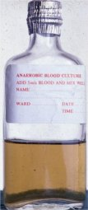
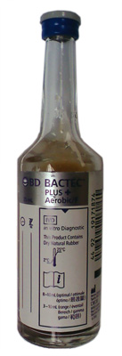
Collected blood is inserted into blood culture bottle containing broth.
-thioglycollate broth
-tryptone soya diphasic medium.
Labelling should be properly done.
The broths are then incubated at 37 ºc for 24 hrs.
If there is delay for incubation, keep the culture as warm as possible but away from direct sunlight.
For serological tests, blood is collected in test tubes.

Slide 7
CEREBROSPINAL FLUID (CSF)
The examination of cerebrospinal ﬂuid (CSF) is an essential step in the diagnosis of bacterial and fungal meningitis.
Normal CSF is sterile and clear.

Slide 8
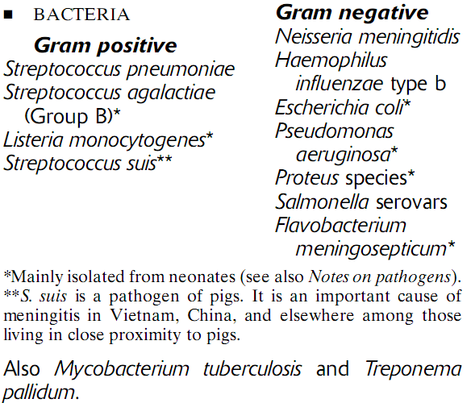
POSSIBLE BACTERIAL PATHOGENS IN CSF

Slide 9
COLLECTION AND TRANSPORT OF CSF
Approximately 5–10ml of CSF should be collected in two sterile tubes by lumbar or ventricular puncture(L3-L4 or L4-L5) performed by a physician.
One sample for culture and other for cell count, microscopy and biochemistry.
It must be collected as asceptically as possible.
Report the appearance of specimen
The specimen should be delivered to the laboratory at once, and processed immediately, since cells disintegrate rapidly.

Slide 10
TRANSPORT
If delay or if the sample needs to be dispatched to microbiology laboratory,
Culture the CSF in chocolate agar, blood agar and Mac conkey agar.(N meningitidis, H influenzae, S pneumoniae are unlikely to survive transportation)
If unable to perform cell count and estimate protein and glucose, transfer CSF to a screw cap bottle containing sodium fluoride oxalate.
Send the inoculated plates and fluoride oxalated sample with request form to microbiology lab within 2.5 hours.

Slide 11
URINE
Urinary tract is normally sterile except for the urethra that may contain a few commensals like Acenatobacter species, diptheroids and yeasts in female.
The most common sites of urinary tract infection (UTI) are the urinary bladder (cystitis) and the urethra. From these sites the infection may ascend into the ureters (ureteritis) and subsequently involve the kidney (pyelonephritis).
Females are more prone to infection of the urinary tract than are males and also present the greater problem in the proper collection of specimens.

Slide 12
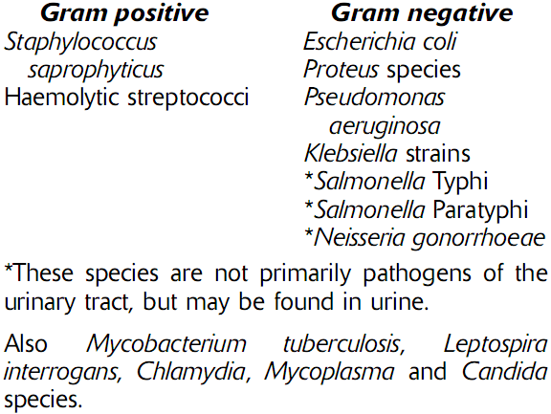
POSSIBLE BACTERIAL PATHOGENS IN URINE

Slide 13
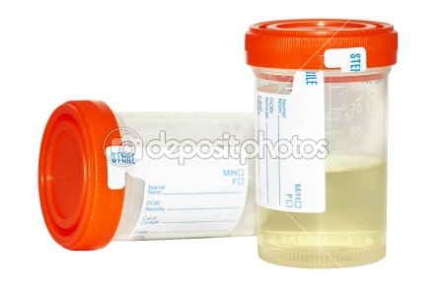
COLLECTION
Give the patient a sterile, dry, wide-necked, leak-proof container and request a 10–20 ml of clean catch mid stream urine specimen.
Explain to the patient the need to collect the urine with as little contamination as possible, i.e. a ‘clean-catch’ specimen.
- Female patients: Wash the hands. Cleanse the
area around the urethral opening with clean water, dry the area with a sterile gauze pad, and collect the urine with the labia held apart.

Slide 14
- Male patients: Wash the hands before collecting a specimen (middle of the urine ﬂow).
Note: When a patient is in renal failure or a young child, it may not be possible to obtain more than a few millilitres of urine.
Label the container with the date, the name and
number of the patient, and the time of collection.
As soon as possible, deliver the specimen with a
request form to the laboratory.

Slide 15
TRANSPORT OF URINE
When immediate delivery to the laboratory is not possible, refrigerate the urine at 4–6°C.
When a delay in delivery of more than 2 hours is anticipated, add boric acid preservative to the urine and refrigerate.
Label the container, and send the urine with a
request form to reach the Microbiology Lab within 48 hours.
When possible examine the urine microscopically in the collection center for bacteria and pus cells to screen for urinary infection

Slide 16
STOOL
Enteric bacterial infections, causing diarrhoea, dysentery, and enteric fevers, are important health problems throughout the world.
With the increasing prevalence of HIV/AIDS and immunosuppressive chemotherapy, diarrhoea in immunocompromised patients has become a growing challenge.
Stool contains normal flora such as E coli, Proteus, Pseudomonas etc.

Slide 17
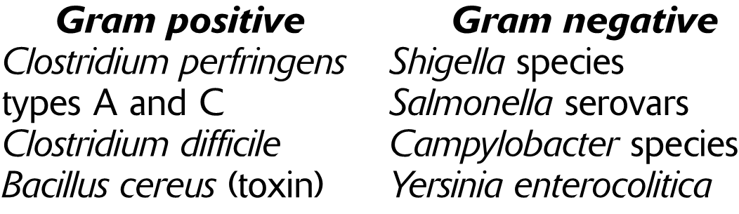
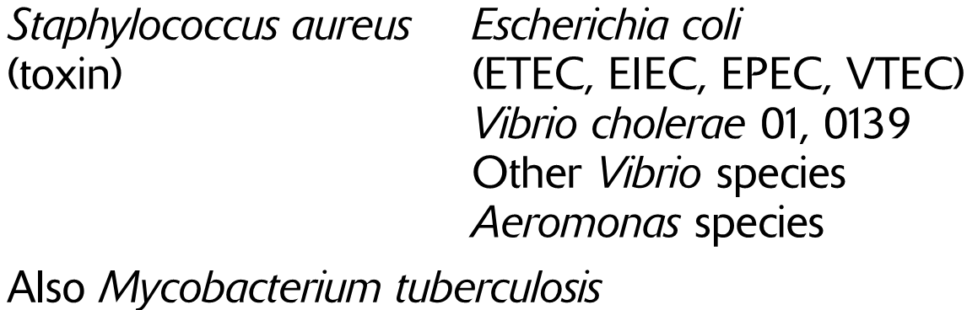
POSSIBLE BACTERIAL PATHOGENS IN STOOL

Slide 18
COLLECTION
Faecal specimens should be collected in the early stages of the diarrhoeal disease, when pathogens are present in the highest number, and before antimicrobial treatment.
Ideally, a fresh stool specimen is preferred to a rectal swab.
Provide the patient with two small wooden sticks and a suitable container with a leakproof lid.
Instruct the patient to collect the stool specimen on a piece of toilet tissue or old newspaper and to transfer it to the container, using the two sticks.
The patient should be asked to deliver the specimen to the clinic immediately after collection.
It should not be contaminated with urine

Slide 19
Label the specimen and send it with a request
form to reach the laboratory within 1 hour (if a
delay longer than 1 hour is anticipated, collect
the specimen in Cary-Blair medium.
When the specimen contains blood or amoebic dysentery is suspected, deliver it to the laboratory as soon as possible. A fresh specimen is required to demonstrate actively motile amoebae and also to isolate shigellae.

Slide 20
TRANSPORT
If there is delay, Transfer a portion of the faeces to a cotton swab. Insert the swab in a container of sterile Cary-Blair transport medium.
When cholera is suspected: Transfer about 1 ml of specimen into 10 ml of sterile alkaline peptone water and label. The specimen should reach the Microbiology Lab within 8 hours of collection.
When worms or tapeworm segments are
present, transfer these (using forceps) to a container of physiological saline and send to the laboratory for identiﬁcation

Slide 21
LOWER RESPIRATORY TRACT INFECTION-SPUTUM
Lower respiratory tract infections (LRTI) are infections occurring below the level of the larynx, i.e. in the trachea, the bronchi, or in the lung tissue (tracheitis, bronchitis, lung abscess, pneumonia).
Sometimes, in pneumonia, the adjacent membranous covering of the lung is involved, resulting in rougheing (pleurisy) and sometimes production of ﬂuid in the pleural cavity (pleural effusion)

Slide 22
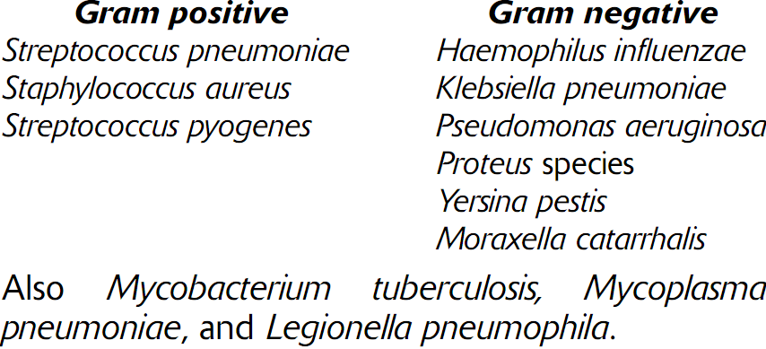
POSSIBLE BACTERIAL PATHOGENS OF LRT

Slide 23
COLLECTION
Give the patient a clean (need not be sterile), dry, wide-necked, leak-proof container, and request him or her to cough deeply to produce a sputum specimen.
Caution: When a sputum specimen is being
collected, adequate safety precautions must
be taken to prevent the spread of infectious
organisms and to avoid contaminating the
outside of the container.

Slide 24
Label the container, and complete a request form
When pneumonia or bronchopneumonia is suspected, deliver the sputum to the laboratory with as little delay as possible because organism such as S. pneumoniae and H. inﬂuenzae require culturing as soon as possible.
When pulmonary tuberculosis is suspected, up to three specimens may need to be examined to detect AFB.
When pneumonic plague is suspected: Deliver the sputum to the laboratory as soon as possible. Make sure the specimen is marked HIGH RISK

Slide 25
TRANSPORT
Send the sputum to laboratory as soon as possible.
For pathogens such as S. pneumoniae and H. inﬂuenzae, transfer a purulent part of the sputum to a cotton-wool swab, and insert it in a container of Amies transport medium. Label the container.
Send the sputum and swab to laboratory within 6 hrs

Slide 26
Describe whether the sputum is:
Purulent: Green-looking, mostly pus
Mucopurulent: Green-looking with pus and mucus
Mucoid: Mostly mucus
Mucosalivary: Mucus with a small amount of saliva
When the sputum contains blood, this must also be reported.

Slide 27
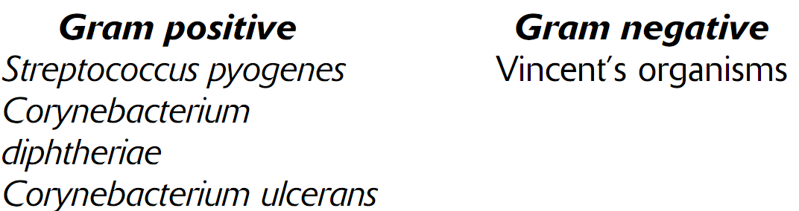
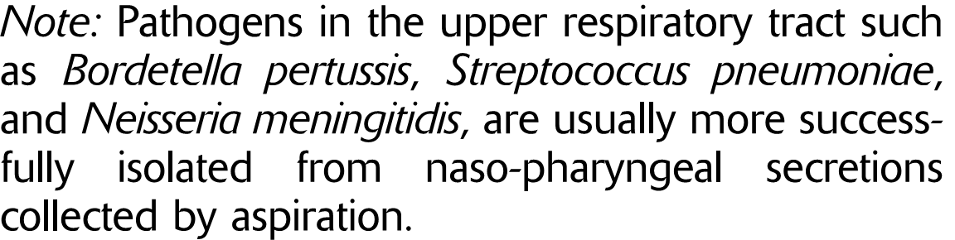
UPPER RESPIRATORY TRACT INFECTION-THROAT AND MOUTH SPECIMEN

Slide 28
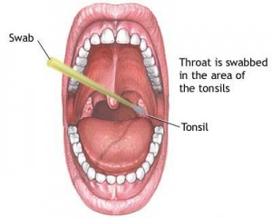
Upper respiratory tract extends from larynx to the nostrils and comprises oropharynx and nasopharynx.
Upper respiratory tract can be site of several types of infections, like:
Pharyngitis
Otitis media
Sinusitis
Epiglottitis.

Slide 29
COLLECTION
Throat and mouth swab should be collected in in a good light and using the handle of a spoon
to depress the tongue. examine the inside of the
Mouth, look for inﬂammation, and the presence
of any membrane, exudate, or pus.
Swab the affected area using a sterile cotton swab. Taking care not to contaminate the
swab with saliva, return it to its sterile container.
Within two hours of collection, deliver the swab
with a completed request form to the laboratory

Slide 30
TRANSPORT
For delivery, the collected swab is kept in tube, sealed with adhesive tape and labelled.
Send the swab with a completed request form to reach the microbiology laboratory within 3 days.

Slide 31
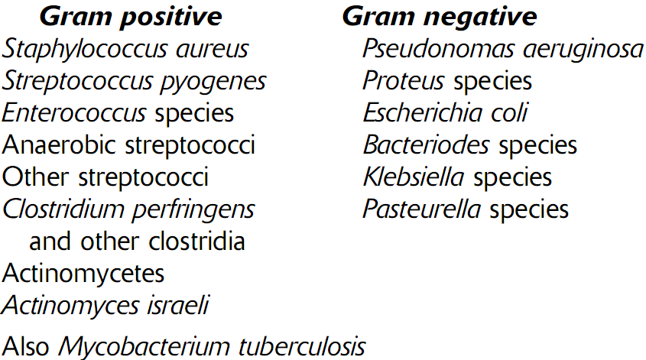
POSSSIBLE BACTERIAL PATHOGEN IN PUS

Slide 32
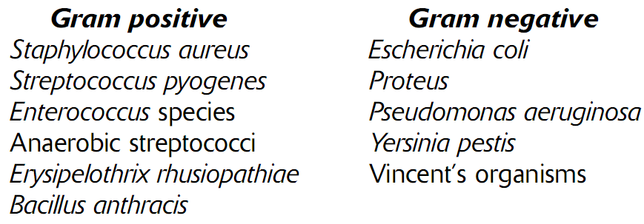
ULCER MATERIALS AND SKIN SPECIMEN

Slide 33
COLLECTION
When collecting pus from abscesses, wounds, or other sites, special care should be taken to avoid contaminating the specimen with commensal organisms from the skin. As far as possible, a specimen from a wound should be collected before an antiseptic dressing is applied.
Aspirate a specimen using a sterile needle and syringe. Transfer to a sterile container.
When pus is not being discharged, use a sterile
cotton-wool swab to collect a sample from the infected site.

Slide 34
TRANSPORT
Collect the specimen using a sterile cotton swab. Insert it in a container of Amies transport medium.
When the material is aspirated ﬂuid from a pustule, transfer the ﬂuid to a sterile, leak-proof
container. Stopper, and seal in a leak-proof
plastic or metal container.
Make a smear (Gram staining) and allow to air-dry in a safe place. Heat-ﬁx the smear.
Send the specimens with a completed request form to reach the microbiology laboratory within 6 hours.

Slide 35
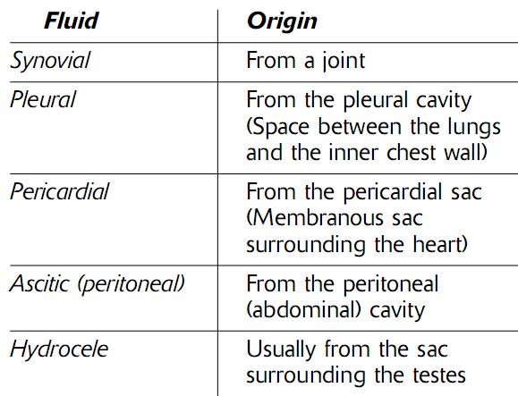
EFFUSION, EXUDATE
An effusion is ﬂuid which collects in a body cavity or joint.
Fluid which collects due to an inﬂammatory process is referred to as an exudate.

Slide 36
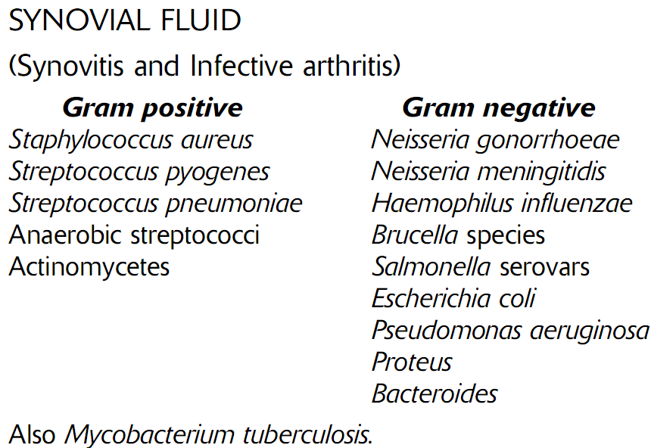
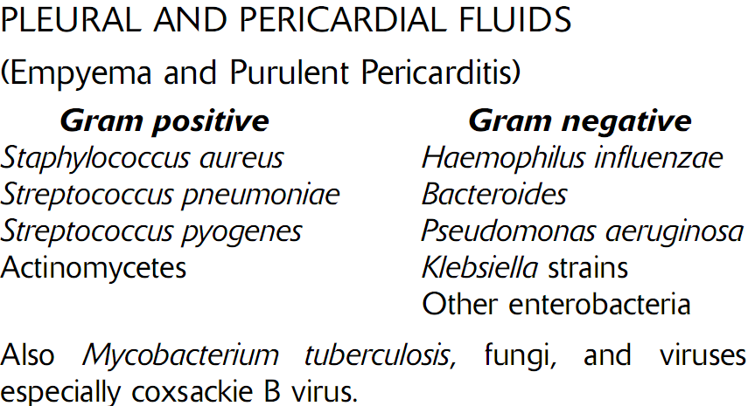
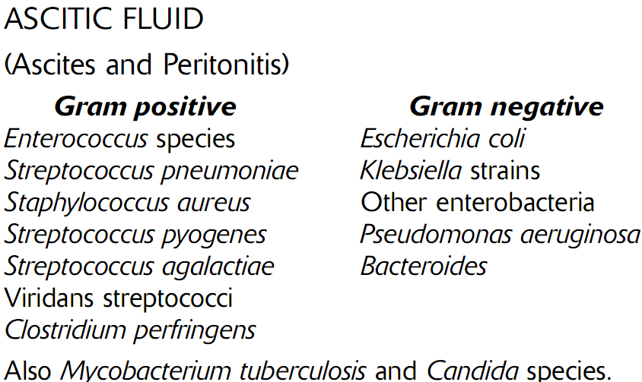
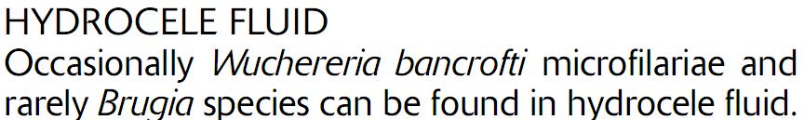

Slide 37
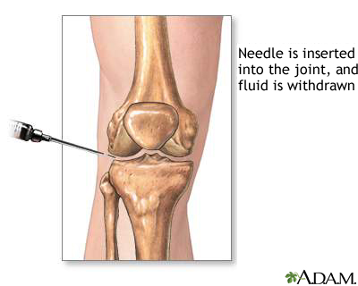
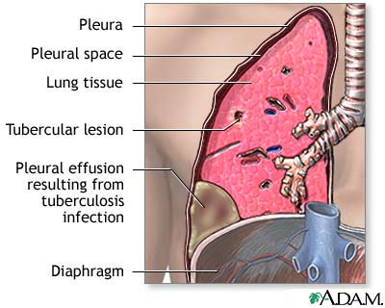
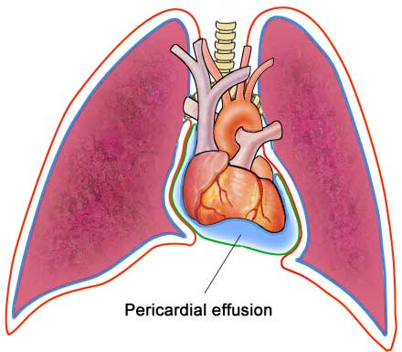
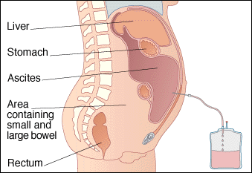
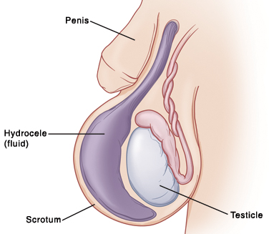

Slide 38
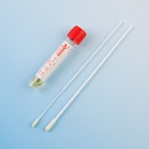
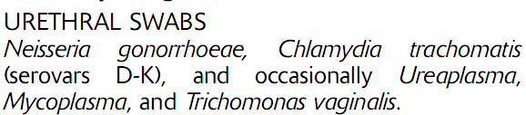
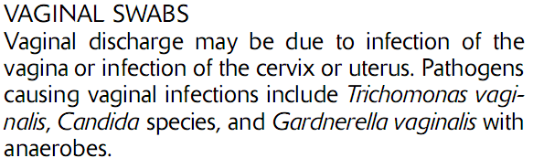
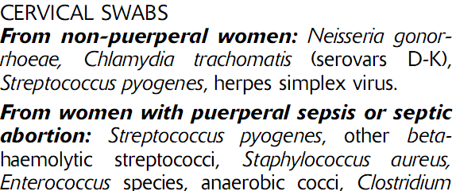
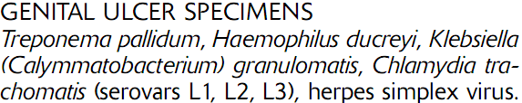
UROGENITAL SPECIMEN

Slide 39
COLLECTION OF URETHERAL DISCHARGE FROM MEN
Cleanse urethral opening using a swab moistened with sterile physiological saline.
Using a swab, collect a sample of discharge. Make a smear of the discharge on microscope slide by gently rolling the swab on the slide.
Allow 2–4 hours after urination before collecting a specimen.
When culture is indicated , collect a sample of pus on a sterile cotton-wool swab. If possible, before inserting the swab in a container of Amies transport medium, inoculate a plate of culture medium

Slide 40
COLLECTION OF CERVICAL SPECIMEN FROM FEMALE
Use a sterile vaginal speculum to examine the cervix and collect the specimen.
Cleanse the cervix using a swab moistened with
sterile physiological saline.Pass a sterile cotton-wool swab 20–30 mm into the endocervical canal and gently rotate the swab against the endocervical wall to obtain a specimen.
When gonorrhoea is suspected, before inserting the swab in Amies transport medium, if possible inoculate a plate of culture medium
Label the specimens and deliver to the laboratory as soon as possible.

Slide 41
PROCESSING OF SPECIMENS
After specimens are arrived at lab, they are processed.
When multiple sample arrive at same time, priority should be given to those that are most critical such as CSF, tissue, blood and sterile fluid.
Urine throat swab , sputam, stool or wound drainages can be saved for latter.
On arrival in the lab, the time and date received should be recorded.

